Slide 1
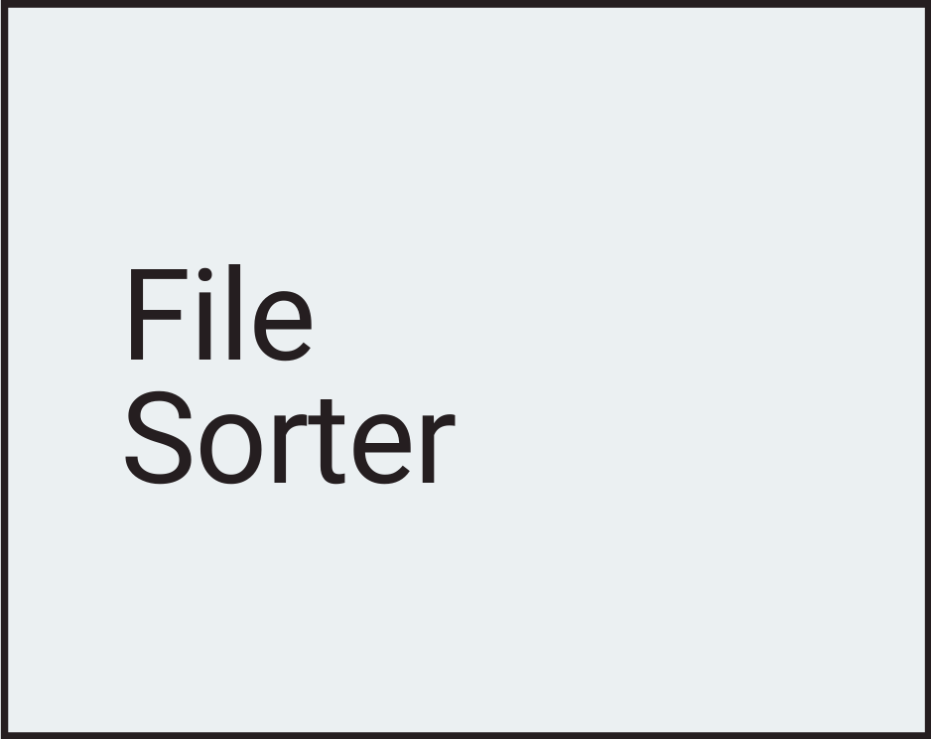
Cairo Lorenzo, 25yo
My talent is calm and creativity
My pitfall is short memory
In 10 years I’ll be keeping developing my projects

Slide 2

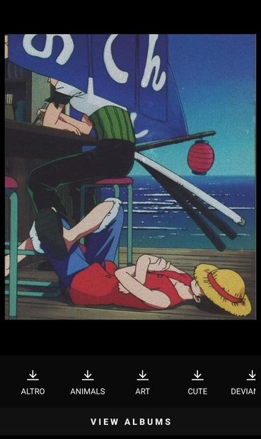
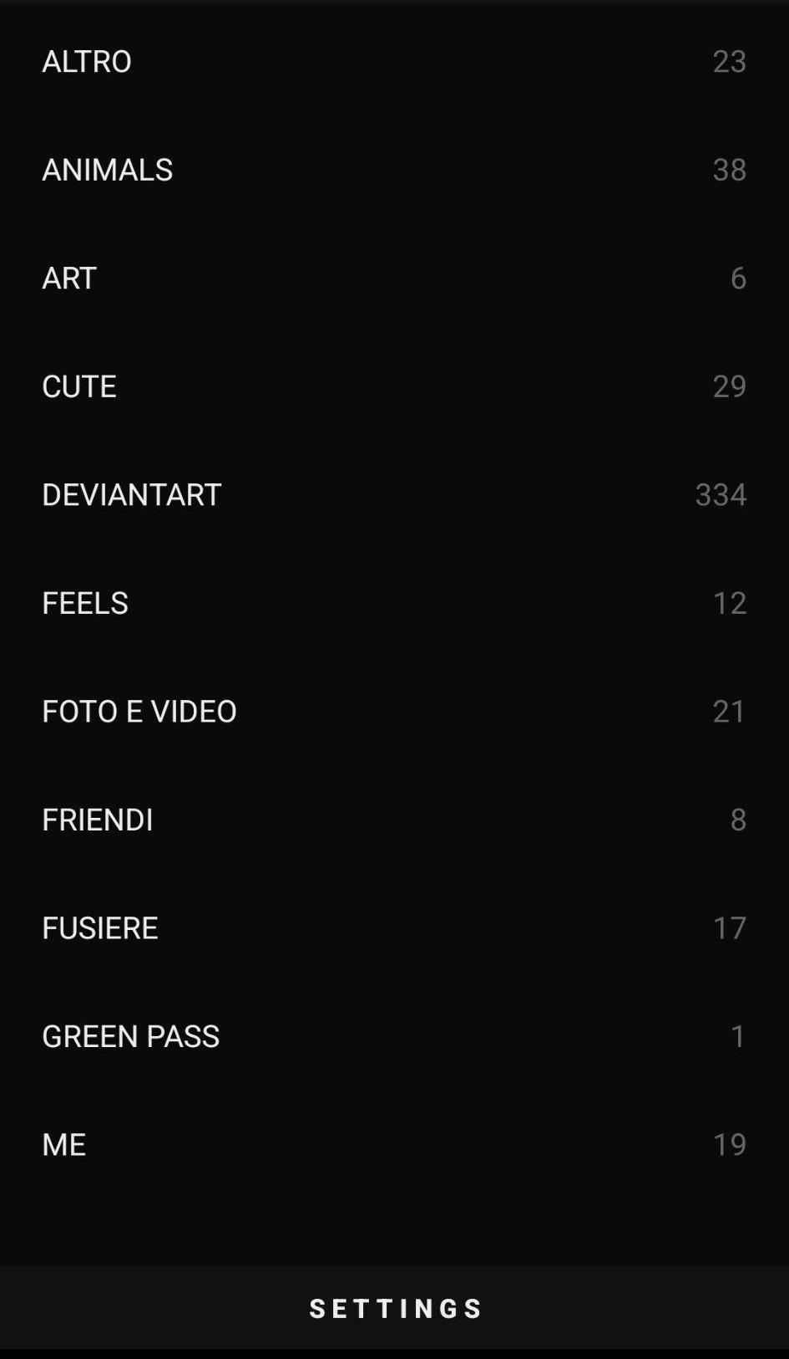
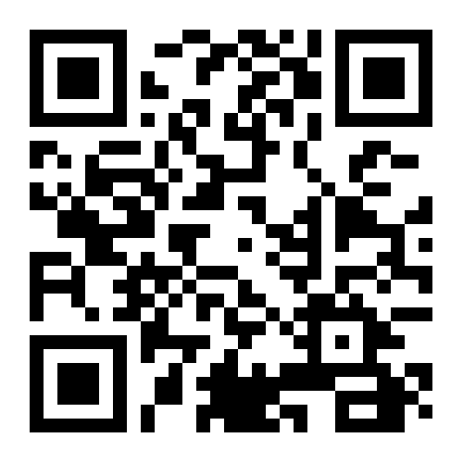
File Sorter
Target age 12+
Tech utility industry
Screens
home page
folder selector
Coming
Soon

Slide 3
Remarks
Competitors/Movers
Slidebox
Simple Gallery
App archivio varie
Est. target size (WW)
~1000000+ Downloads
~500000+ App Purchased
Revenue model
Subscription to access more features
Banner ads
Revenue est.
App Purchased: 0,99 USD
Banner ads: dbetween %0.50 and $1.20 per 1,000 impressions served.
(3) data source IX-Rapporto-CSR-in-Italia.pdf, is a 2y CSR report made by Osservatorio Socialis
Interested? See more

